Slide 1




PREDICTING RESTAURANT RATINGS
USING MACHINE LEARNING TO PREDICT AGGREGATE RATINGS

Slide 2
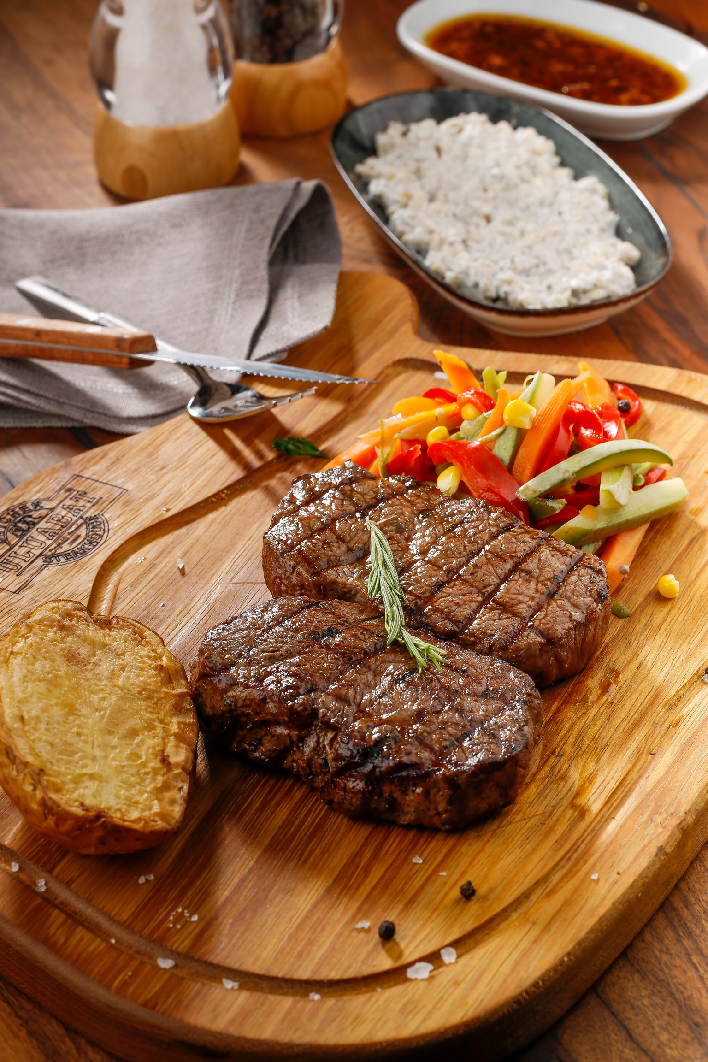
INTRODUCTION
Objective
Develop a machine learning model to predict the aggregate rating of a restaurant based on various
features related to the restaurant's characteristics and operations.

Slide 3
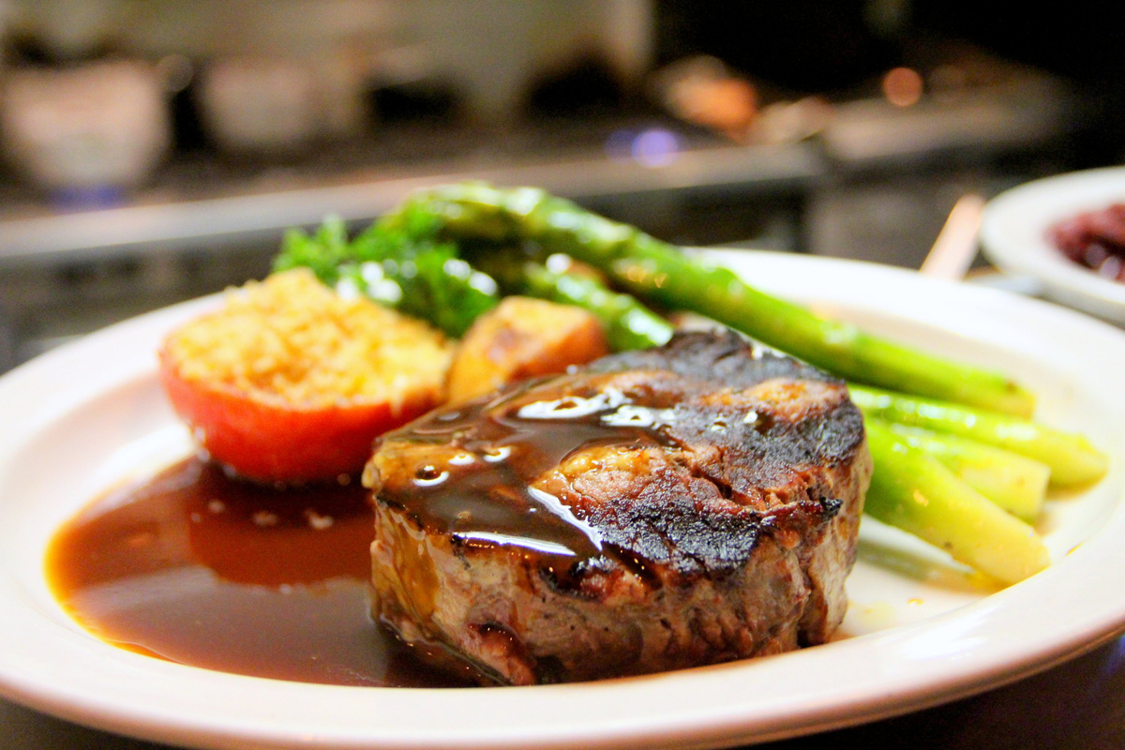
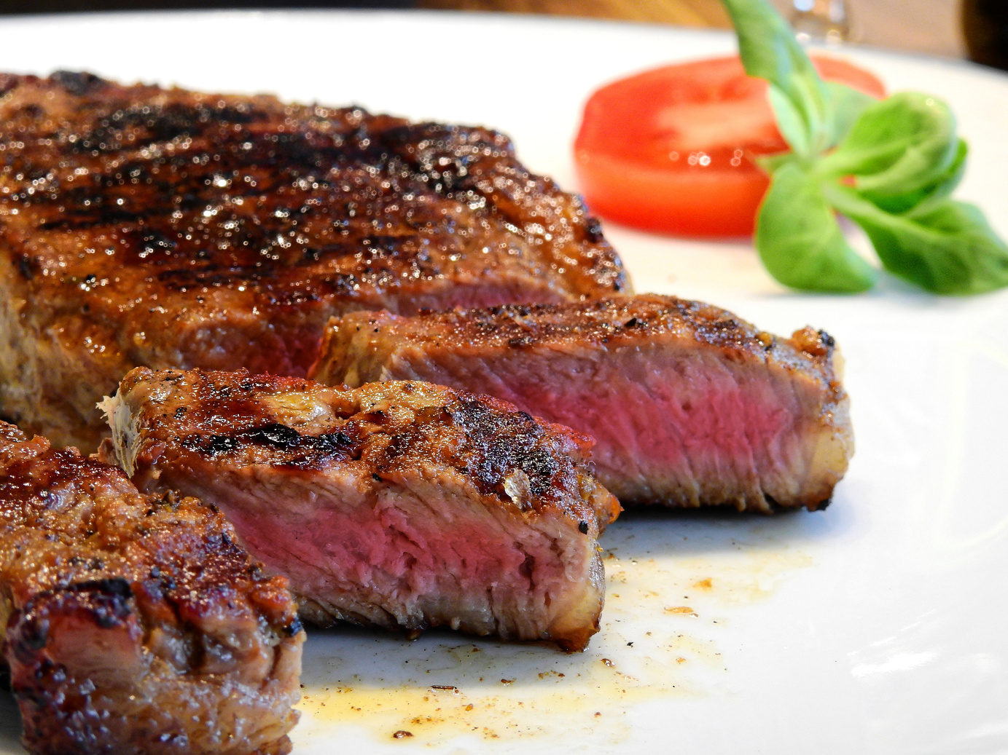
OUTLINE OF PRESENTATION
Dataset Description
Data Preprocessing
Exploratory Data Analysis
Feature Selection
Model Selection
Model Training and Evaluation
Results and Insights
Challenges and Limitations
Conclusion

Slide 4
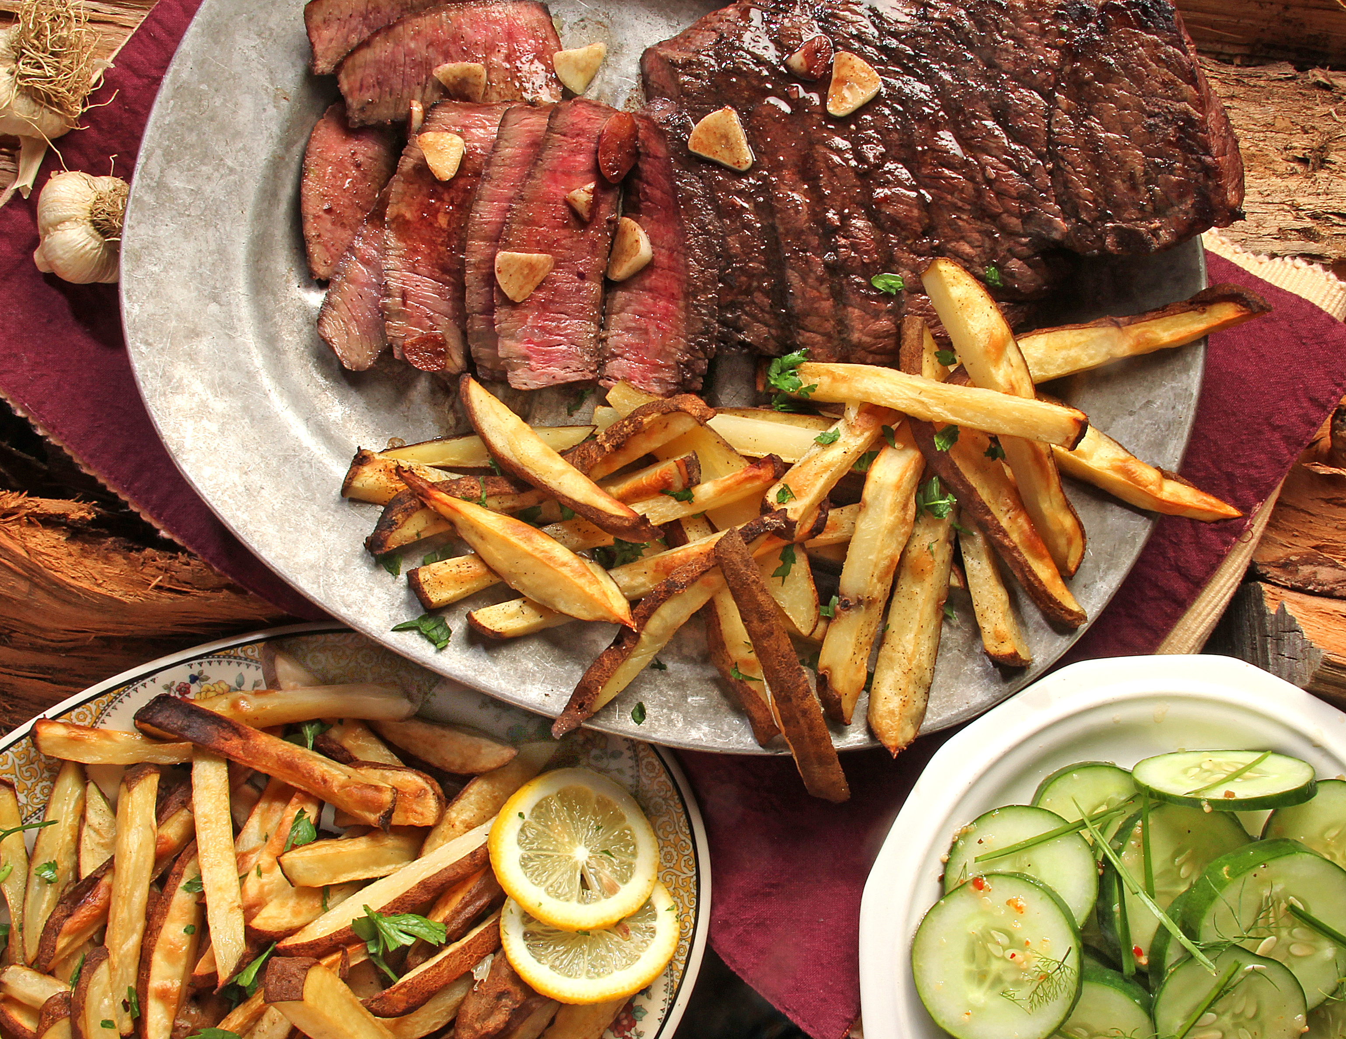
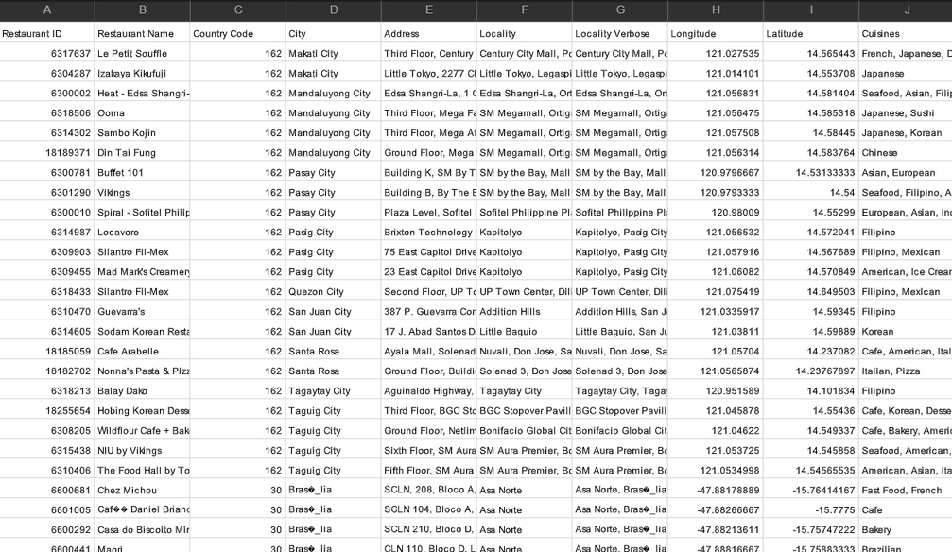
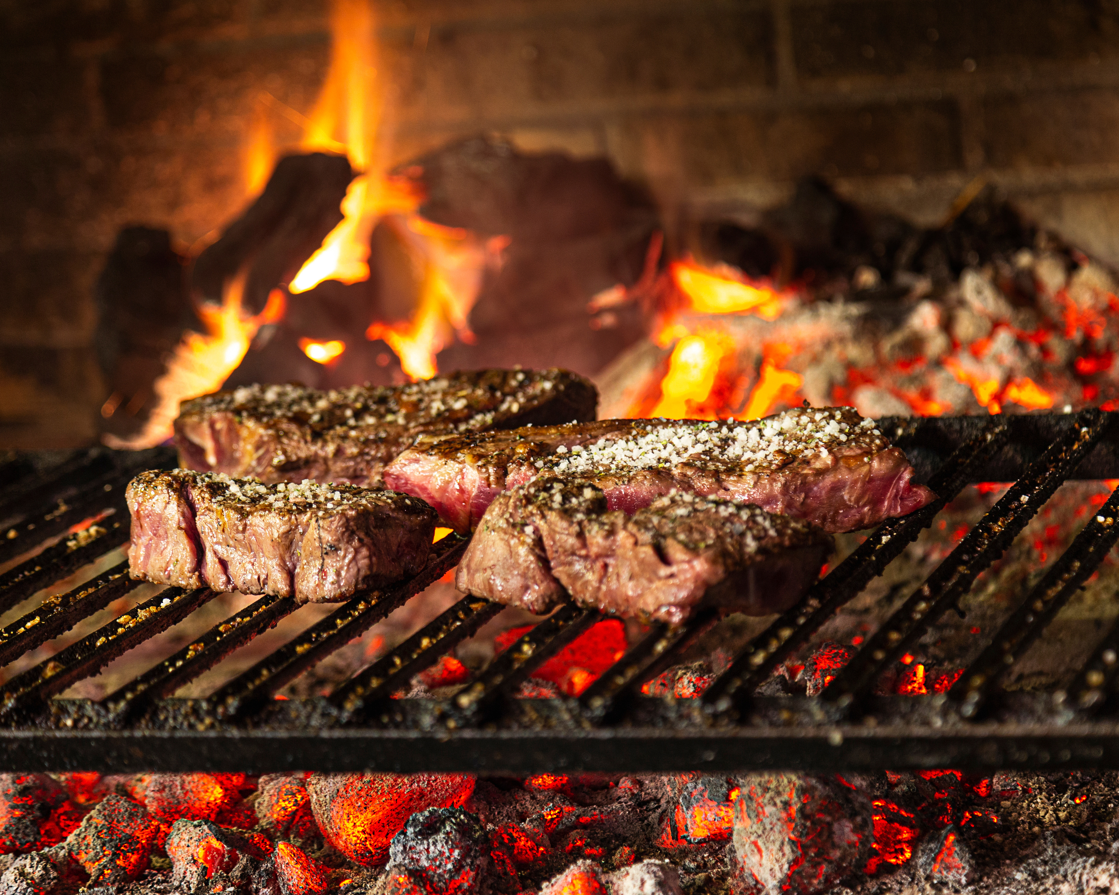
Key Columns
Restaurant ID: Unique identifier for each restaurant.
DATASET DESCRIPTION
Restaurant Name: Name of the restaurant.
Country Code: Numeric code representing the country.
City: Name of the city.
Locality: Neighborhood where the restaurant is located.
Price Range: Price range category of the restaurant.
Votes: Number of votes received by the restaurant.
Cuisines: Types of cuisines offered.

Slide 5
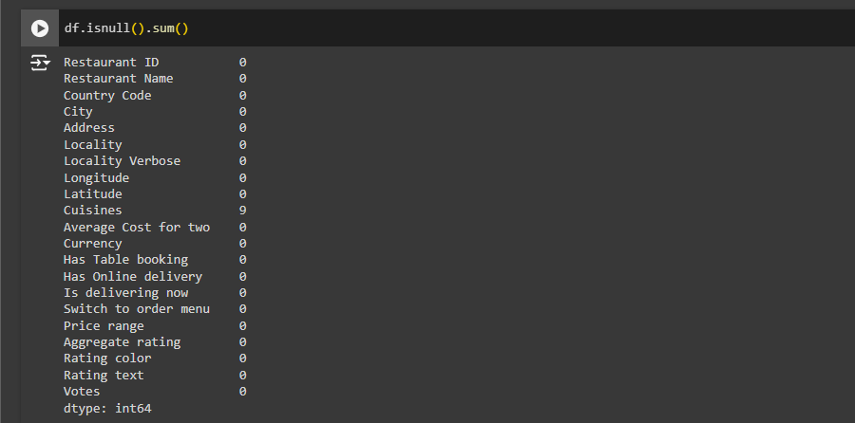
DATA PREPROCESSING
Visuals
Steps Involved
Handling missing values.
Encoding categorical variables.
Scaling numerical features.

Slide 6
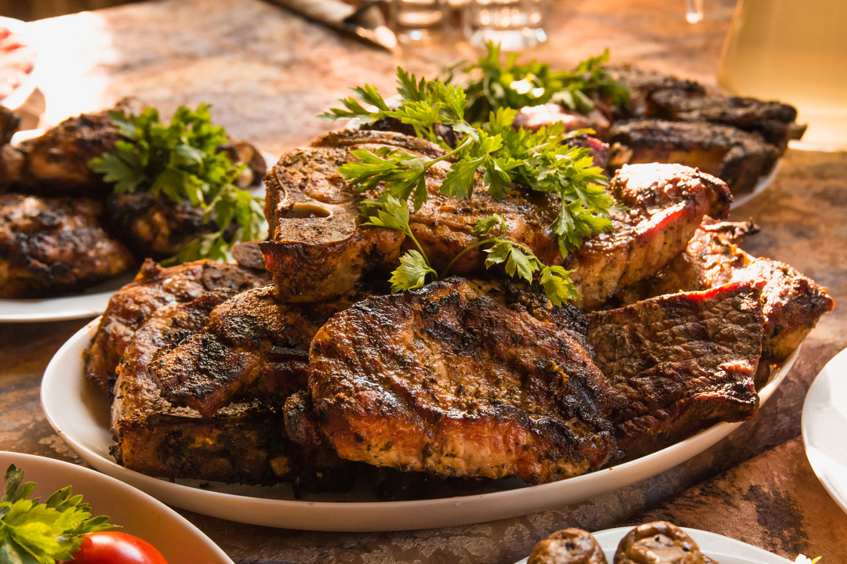
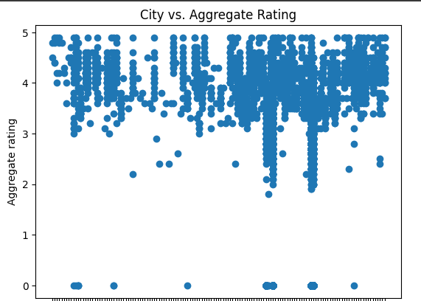
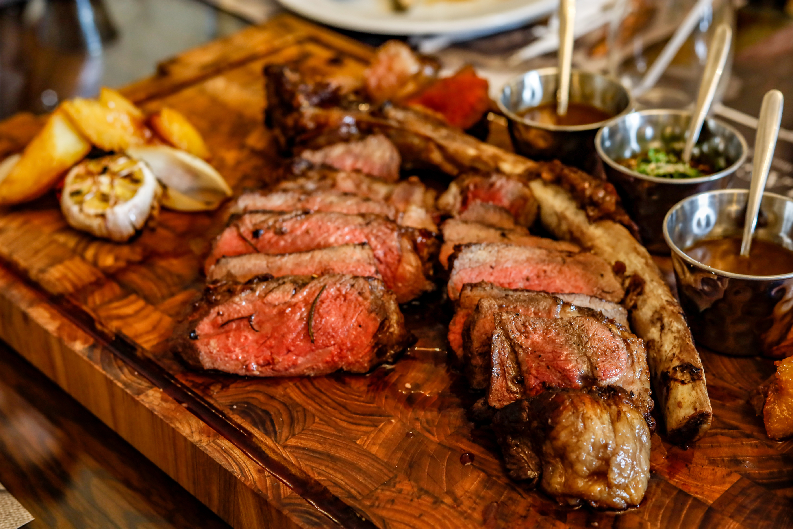
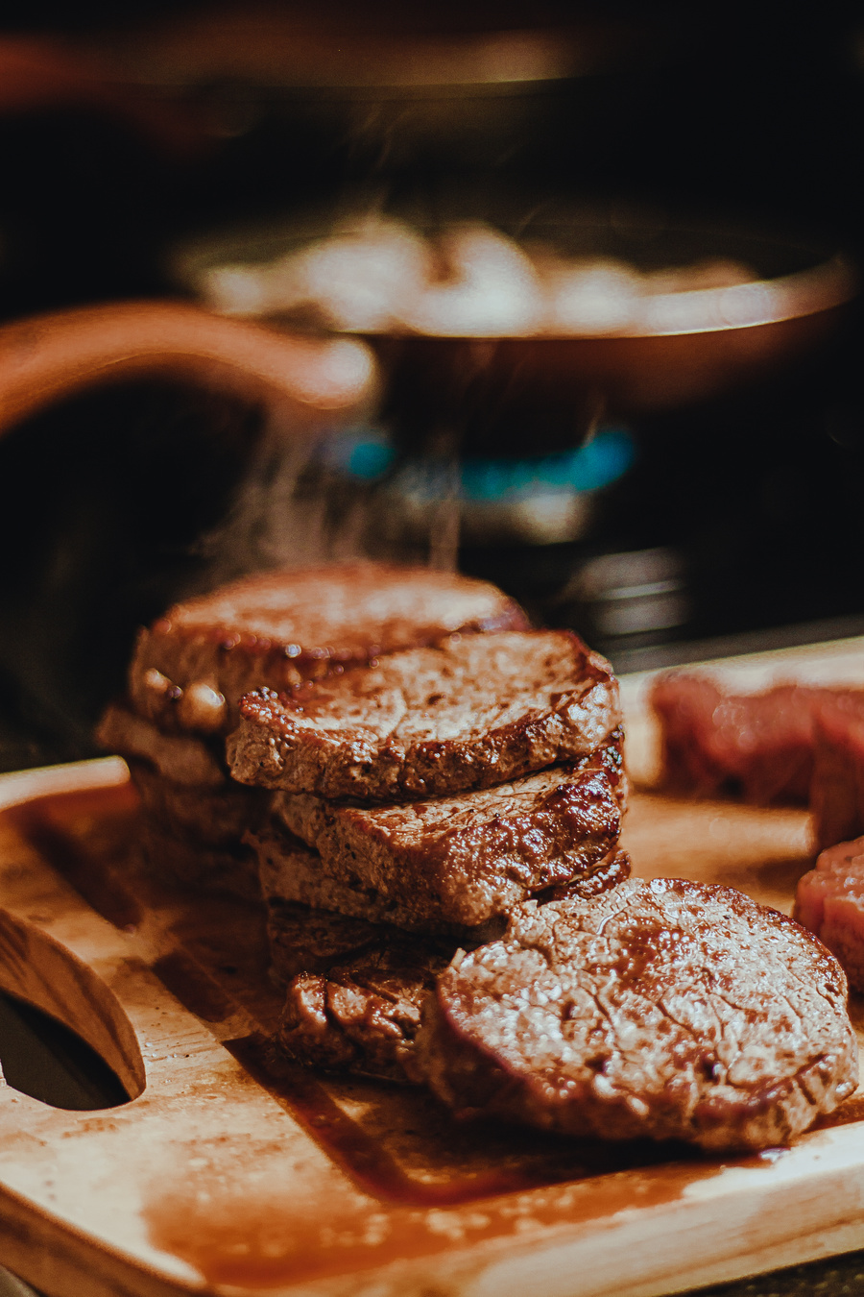
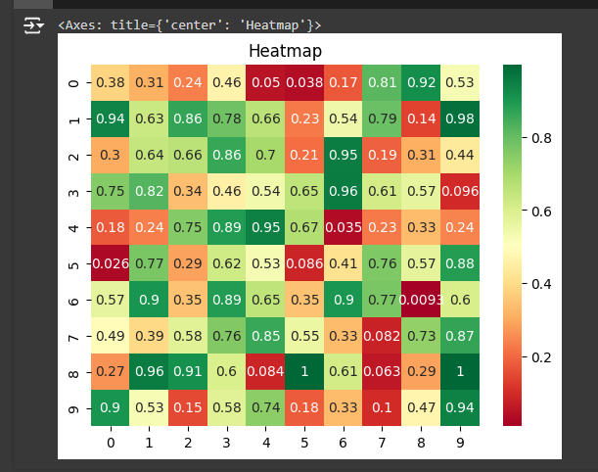
Exploratory Data Analysis (EDA)
01
Purpose: Understanding the data and identifying patterns.
02
Key Insights:
Distribution of ratings.
Popular cuisines.
City vs. Aggregate Rating
03
Visuals

Slide 7
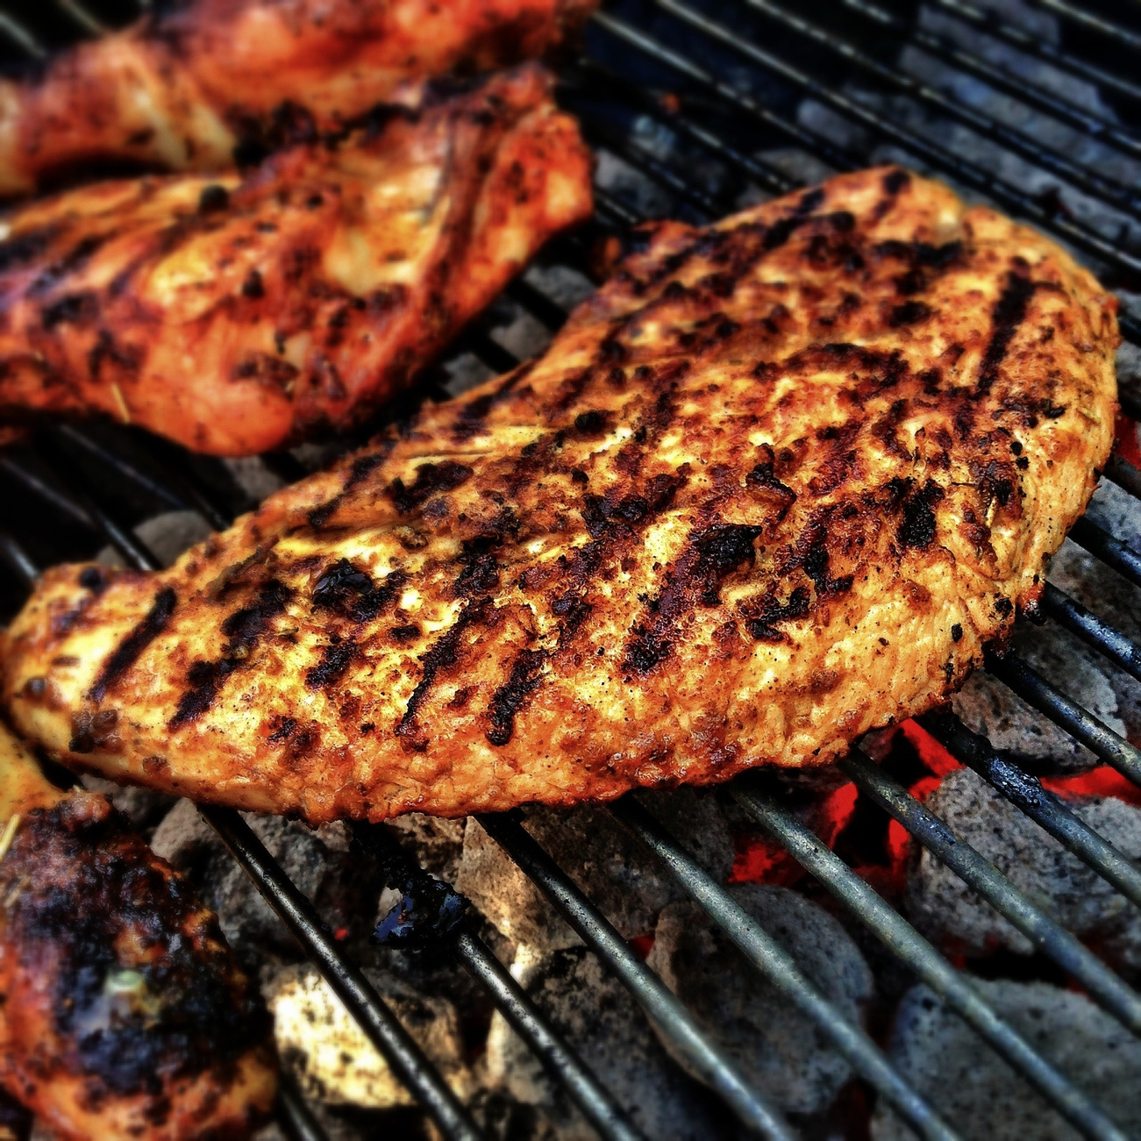
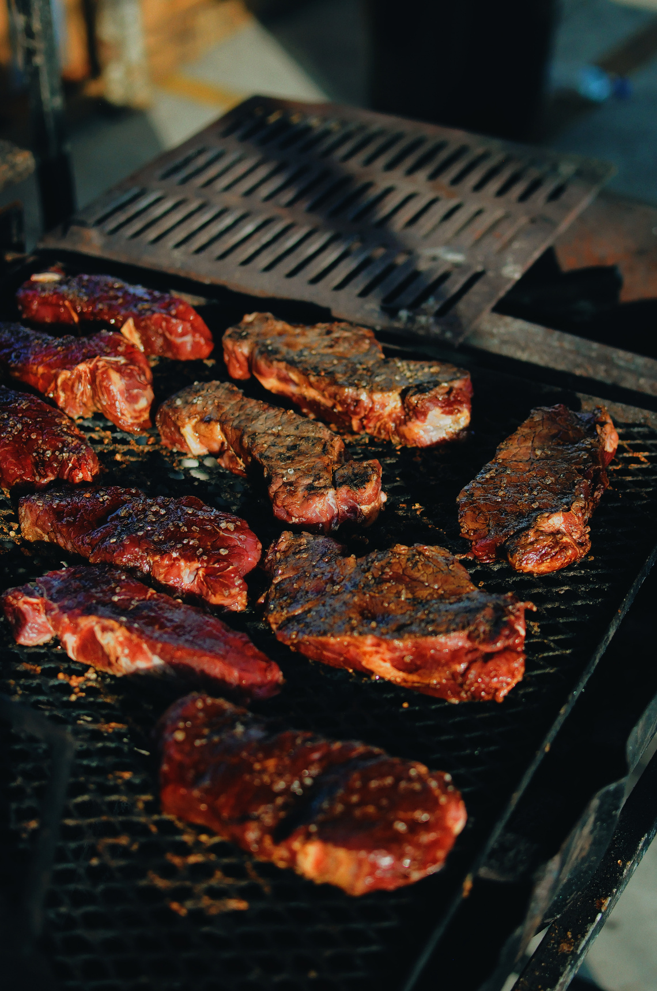

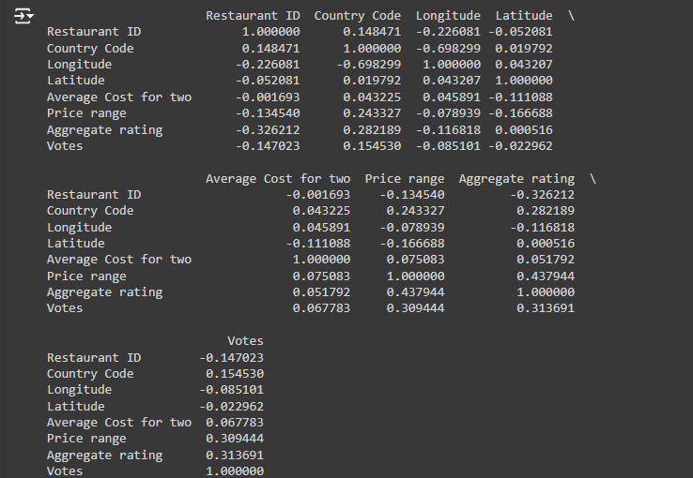
FEATURE SELECTION
1
Objective: Identify the most important features for prediction.
2
Methods Used:
Feature importance from models
Correlation matrix.
3
Visuals:

Slide 8




MODEL SELECTION
Algorithms Tried
Linear Regression.
1.104
1.326
1.759
0.226
mean_absolute_error
root_mean_squared_error
mean_squared_error
R^2 score

Slide 9
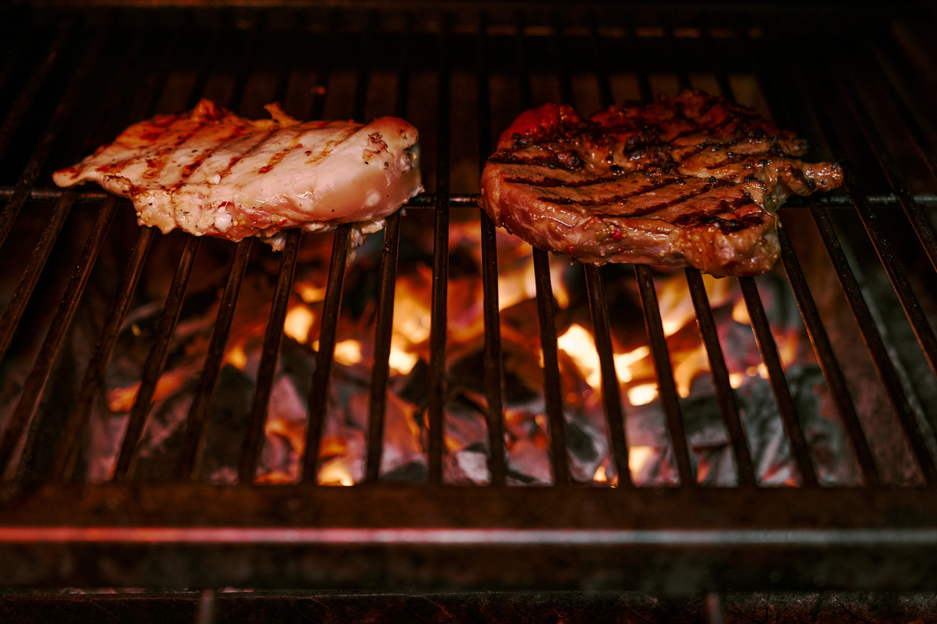


MODEL TRAINING AND EVALUATION
Selected Model:
Model Chosen: Linear Regression
Reason for Selection: Simplicity, interpretability, and effectiveness for predicting continuous outcomes.
Training Process:
Data Splitting:
Training Set: 80%
Testing Set: 20%

Slide 10
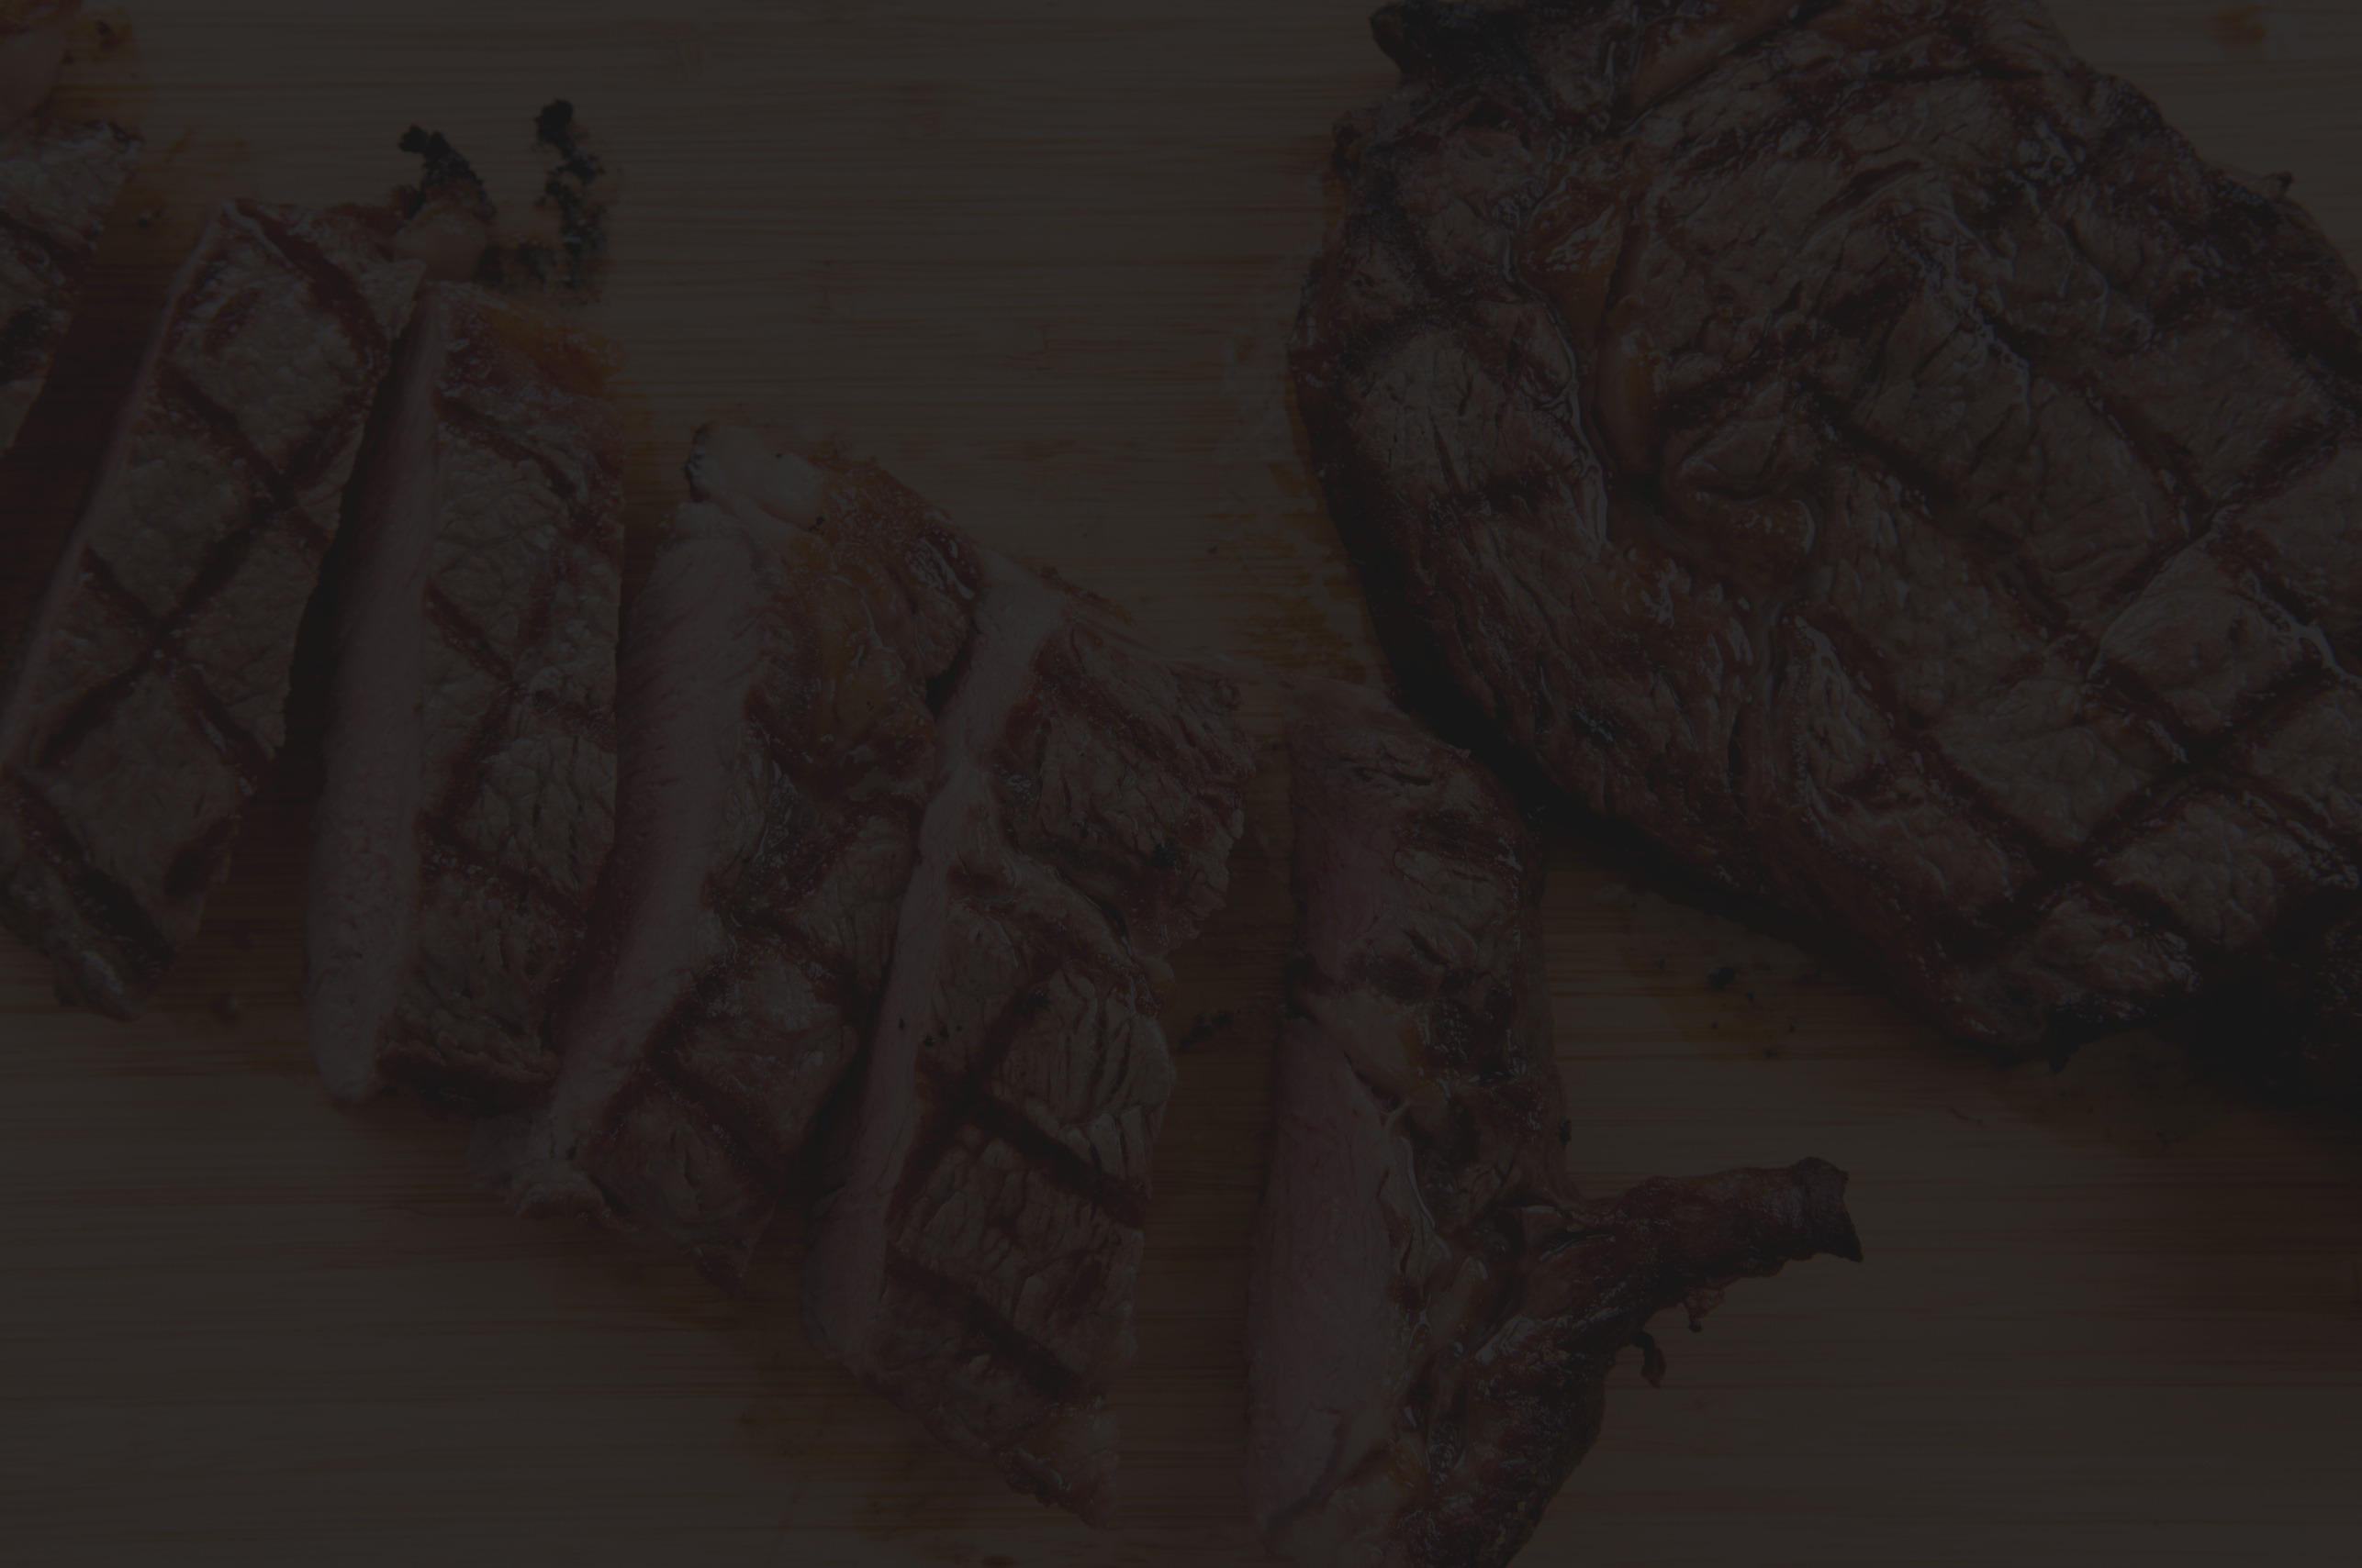
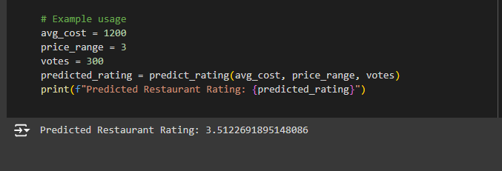
RESULTS AND INSIGHTS
Key Findings:
Important features affecting restaurant ratings.
Patterns observed in the data.
Example

Slide 11

Thank You

